Slide 1
E-Rate Program
Eligible Services
May 10, 2011 – Atlanta I May 15, 2011 – Los Angeles

Slide 2
Eligible Services for FY 2012
Overview
Priority One:
Telecommunication services, telecommunications and Internet access (IA)
Priority Two:
Internal connections (IC) and Basic maintenance of IC (BMIC)
Trending Topics
BMIC continued
Dark fiber
VoIP
Open issues

Slide 3
Eligible Services
Overview

Slide 4
Overview
Priority 1 – Telecommunications Services
Support for telecom services
Examples:
Local and long distance service
Cellular service
Text messaging
Ethernet

Slide 5
Overview
Priority 1 – Telecommunications Services
Other examples of eligible telecom services:
T-1, T-3
DSL
PRI
Satellite service
Interconnected Voice over Internet Protocol (VoIP)
Taxes and certain fees
Installation and configuration

Slide 6
Overview
Priority 1 – Telecommunications Services
Some examples of services NOT eligible:
Broadcast “Blast” messaging
Monitoring services for 911, E911 or alarm telephone lines
The actual circuit itself is eligible
Services to ineligible locations
End-user devices

Slide 7
Overview
Priority 1 – Telecommunications Services and Telecommunications
Telecommunications Services and Telecommunications are now two categories on the Eligible Services List (ESL).
Telecommunications Services can only be provided by an eligible telecommunications carrier.
Telecommunications can be provided by non-telecommunications carriers via fiber in whole or in part.

Slide 8
Overview
Priority 1 – Internet Access
Support for Internet access includes the Internet Service Provider (ISP) fees and the conduit to the Internet.
Internet-related services funded under the Internet access category also include:
E-mail Service,
Web Hosting, and
VoIP.

Slide 9
Overview
Priority 1 – Internet Access
Some examples of services NOT eligible:
Filtering
Costs for Internet content
Subscription services such as monthly charges for on-line magazine subscriptions
Internet2 membership dues
Web site creation fees
Software, services, or systems used to create or edit Internet content

Slide 10
Overview
Priority 1 - Tips
If your service includes on-premise equipment, provide your customer with the make and model.
If you are offering an ineligible service along with eligible services, do not forget to break out any of the costs associated with installation, training and taxes associated with the ineligible services.
If you have a new service or re-naming a pre-existing service, be sure to supply your applicant with a description of the service to ensure the PIA reviewer understands the exact service you are providing.

Slide 11
Overview
Priority 2 – Internal Connections
Support for equipment and cabling on-site that transport information to classrooms or public rooms of a library.
Does NOT include end-user components such as computers, printers and projectors.
Subject to the Two-in-Five Rule.
Entities can only receive funding every two out of five years.

Slide 12
Overview
Priority 2 - Internal Connections

Slide 13
Overview
Priority 2 - Internal Connections

Slide 14
Overview
Priority 2 – Basic Maintenance of Internal Connections
Allows for support for basic maintenance of eligible internal connections.
Examples:
Repair and upkeep of eligible hardware
Wire and cable maintenance
Basic technical support
Configuration changes

Slide 15
Overview
Priority 2 – Basic Maintenance of Internal Connections
Agreements or contracts must state the eligible components covered by make, model and location.
Service must be delivered within the July 1st to June 30th timeframe.
Two-in-Five Rule does not apply to BMIC.

Slide 16
Overview
Priority 2 - Tips
As with the Priority One services, be sure to identify costs associated with ineligible charges such as tax, installation and training along with the cost(s) of the ineligible product(s).
Refer to the Eligible Services List to ensure services and products seeking a service substitution are of the same functional category.
Incorporate the make, model and quantities of the products you will be maintaining into your maintenance contract to ensure PIA reviewers understand what products are being supported.

Slide 17
Eligible Services
Trending Topics

Slide 18
Trending Topics
Basic Maintenance of Internal Connections
Unbundled warranties are NOT eligible.
Unbundled warranties allow for broken equipment to be fixed or if it is beyond repair, replaced.
Unbundled warranties are considered a type of retainer and not as an actual maintenance service.
This does not apply to a manufacturer’s warranty of no more than three years that is included in the price of the equipment , OR
If the retainer is tied to actual service performed.

Slide 19
Trending Topics
Basic Maintenance of Internal Connections
Applicants may make estimates based on:
Hours per year of maintenance,
History of needed repairs and upkeep, and
Current life of eligible internal connections.
Provision of this information as part of the Item 21 attachment can reduce the time it takes to receive a funding commitment.
Basic maintenance will be paid on the actual work performed and hours used only.

Slide 20
Trending Topics
Basic Maintenance of Internal Connections
BMIC costs must be a bona fide request.
It is not reasonable to estimate an amount that would cover the cost of every piece of eligible equipment.
While replacement of hardware may be eligible as BMIC, it is not meant to circumvent the 2-in-5 rule.

Slide 21
Trending Topics
Leased Dark Fiber for FY 2011 and forward
Introduced as “Telecommunications” in the FY2011 Eligible Services List.
Allows for support for lit or dark fiber, as a priority one service, from any entity.
On the FCC Form 471, applicants are instructed to select the Telecom box if the leased fiber is provided by a telecom carrier.
In all other cases, the applicant should select the Internet access box.

Slide 22
Trending Topics
Leased Dark Fiber
Dark fiber must be lit immediately.
Immediately means the fiber must be lit during the funding year in which you request services in order to receive E-rate discounts.
USAC will not pay for recurring or non-recurring charges until the fiber is lit.
Does NOT allow for unneeded capacity or warehouse dark fiber for future use
The Commission’s intent was to provide applicants more flexibility when considering fiber as a solution to meet their needs, not to acquire dark fiber for future use.

Slide 23
Trending Topics
Leased Dark Fiber
Maintenance costs of dark fiber and installation costs to hook up the dark fiber are eligible
This includes charges for installation within the property line (see next page for eligibility matrix)
Modulating electronics for leased dark fiber are not eligible
Eligible only as applicant owned priority 2 if it meets the definition of an internal connection. If being used for LAN traffic it is eligible; if WAN, not eligible.

Slide 24
Trending Topics
Leased Dark Fiber Installation Diagram
Special Construction charges to build out connections from applicants’ facilities to an off-premise fiber network are NOT eligible.

Slide 25
Trending Topics
Leased Dark Fiber
Some examples of not eligible special construction charges include:
Design and engineering costs,
Project management costs,
Digging trenches, and
Laying fiber.

Slide 26
Trending Topics
Leased Dark Fiber
Dark fiber is not eligible as a Priority 1 service between two buildings on the same campus.

Slide 27
Trending Topics
Leased Dark Fiber
Dark fiber is eligible as an Internal Connection servicing two buildings on the same campus.

Slide 28
Trending Topics
Dark Fiber Install and Maintenance Matrix
 | Description | P1- Leased Lit Fiber | P1- Leased Dark Fiber | P2- Leased Lit or Dark Fiber | P2- Purchased Dark Fiber
1 | Installation within property from bldg to bldg | Not Eligible | Not Eligible | Eligible | Eligible
2 | Installation on property from bldg to property line | Eligible | Eligible | Not Eligible | Not Eligible
3 | Installation off property from curb to service provider | Eligible | Not eligible | Not Eligible | Not Eligible
4 | Monthly service charges within property from bldg to bldg | Not Eligible | Not Eligible | Eligible | Not Eligible
5 | Monthly service charges from bldg to service provider or to off-site bldg | Eligible | Eligible | Not Eligible | Not Eligible
6 | Maintenance charges from bldg to bldg | Not Eligible | Not Eligible | Eligible | Eligible
7 | Maintenance charges from bldg to service provider | Eligible | Eligible | Not Eligible | Not Eligible

Slide 29
Trending Topics
VoIP
Interconnected VoIP is defined as a service that:
Enables real-time, two-way voice communications
Requires a broadband connection from the user’s location
Requires Internet protocol-compatible customer premises equipment (CPE)
Permits users generally to receive calls that originate on the public switched telephone network and to terminate calls to the public switched telephone network.

Slide 30
Trending Topics
VoIP
Priority 1 Services
May be applied for in either telecommunications or Internet access on an applicant’s FCC Form 470.
USAC highly recommends applicants to post in both the telecommunications service and Internet access categories of service.

Slide 31
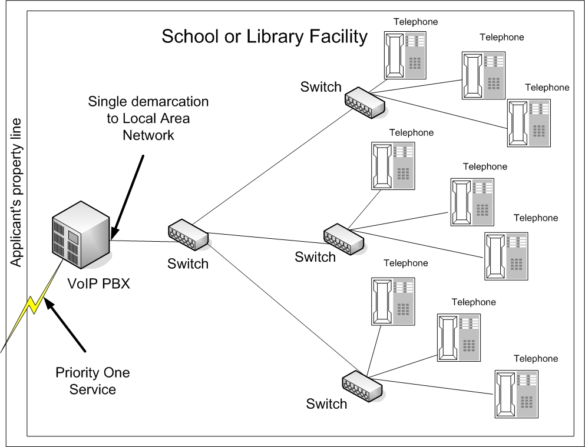
Trending Topics
VoIP
A leased VoIP phone system is NOT eligible for Priority 1 funding
By removing the VoIP equipment, the local voice network will cease to function. This equipment is eligible ONLY as Internal Connections.

Slide 32
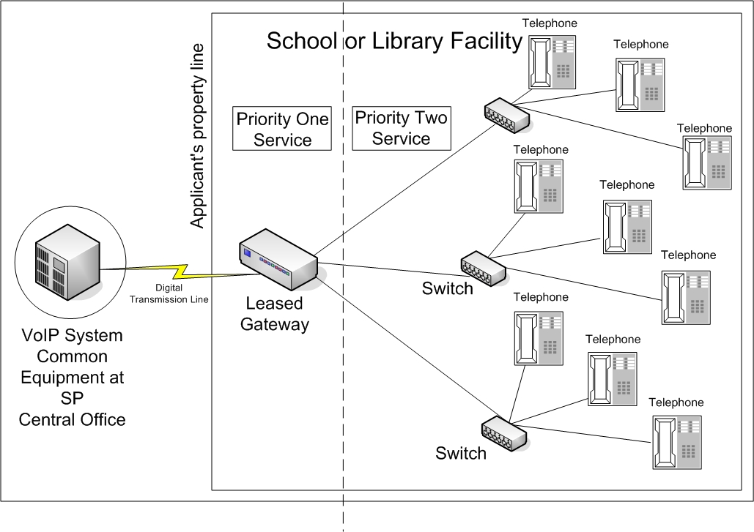
Trending Topics
VoIP
A gateway may be leased with eligible Priority 1 VoIP service.
A gateway is considered a single basic terminating device.

Slide 33
Trending Topics
VoIP
Priority 2 – VoIP components are eligible.
Includes:
VoIP phone system,
VoIP router and/or switches, and
Software licenses for the functioning of the IP telephone devices.
Excludes:
End-user devices e.g. IP phones and Softphones.

Slide 34
Trending Topics
Open Issues
Is the receipt of multiple forms of a service duplicative?
E.g., a school receives funding for T-1 service for Internet access and a teacher in a room that has access to the T-1 service uses an air card to access the Internet.
Are free VoIP handsets permissible if provided to all customers?
DA 10-2355 states, “For example, many cell phones are free or available to the general public at a discounted price with the purchase of a two-year service contract. Schools and libraries are free to take advantage of these deals, without cost allocation, but cannot accept other equipment with service arrangements that are not otherwise available to some segment of the public or class of users.”

Slide 35
Eligible Services
Questions?

