Slide 1
How to Use the Portal
E-rate Program Applicant Training
October – November 2015
Washington DC • Tampa • Albuquerque • Minneapolis • New Orleans • Los Angeles • Philadelphia • Portland

Slide 2
Overview
Using the Portal
Advantages of the portal
How to log in
How to create a new user
My Landing Page
How to update entity information
How to modify an account administrator
How to add a consultant

Slide 3
Why Move to a Portal?
Using the Portal
Move to one location for all program activities.
Complete and certify program forms
Obtain the status of applications
Submit requests
Receive timely reminders and notifications
Respond to PIA questions
Ask USAC questions
Improve the customer experience.
Streamline the application process.

Slide 4
Advantages of the Portal
Using the Portal
All of your forms, submitted documentation, and requests will be in one location online and easily accessible.
Users can access the portal from any device (e.g., desktop computer, laptop computer, tablet, smartphone) and any browser.

Slide 5
Advantages of the Portal
Using the Portal
School districts and library systems can update and store address information and other data on their individual schools and libraries. This information can then be uploaded into online forms so that you do not have to re-enter it every year.
Consortia and statewide applicants will have a complete list of their members, and service providers and consultants will have a complete list of their clients.

Slide 6
Advantages of the Portal
Using the Portal
Applicants will no longer need a Personal Identification Number (PIN) to certify forms.
Account administrators can create as many account users as they wish, and decide which activities the users can perform (i.e., set their permissions or user rights).

Slide 7
How to Log In
Logging In
USAC creates an account for the applicant organization and identifies an account administrator.
Applicant organization types:
Independent school
Independent library
School district
Library system
Consortium / statewide applicant

Slide 8
How to Log In
Logging In
USAC sends an invitation email to the account administrator to log in to the portal.
The account administrator goes to portal.usac.org, enters his or her email address – the “Username” – and clicks “Forgot Password.” NOTE: As long as the account administrator has been set up in USAC’s system, it is not necessary to locate the invitation email.
The account administrator then re-enters the email address and clicks “Request Password Reset.”

Slide 9
How to Log In
Logging In
USAC sends a second email with a link to create a password. This link is only valid for 15 minutes.
The account administrator clicks the link, enters the email address, and creates a “new” password.
After clicking “Reset Password,” the account administrator can click the link provided to log in.
After logging in with the email address (“Username”) and password, the account administrator clicks the link to accept the terms and conditions of use.

Slide 10
Video Demo – How to Log In
Recorded demonstration of the login process

Slide 11
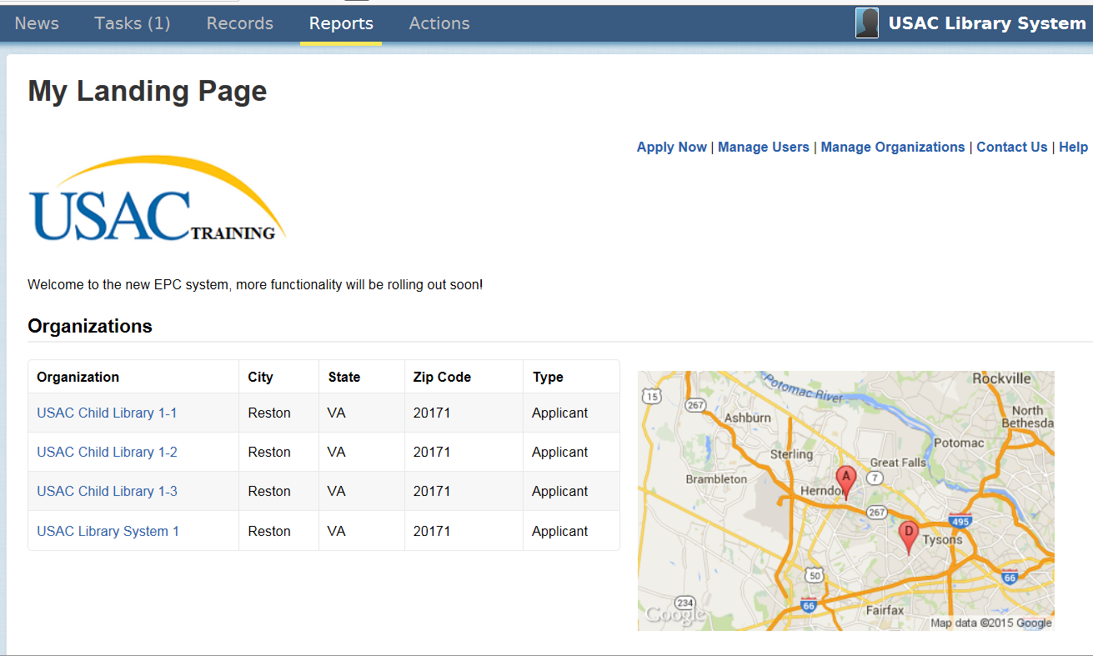

Slide 12
Live Demonstration
Live demonstration of the EPC system

Slide 13
Where to go for help
Getting Assistance
Call the Client Service Bureau at (888) 203-8100 for help with the following:
Verifying accounts and account administrators
Updating profile information
Creating new users and updating existing users
Linking organizations
General questions about the portal

Slide 14
Where to go for help
Getting Assistance
Visit the USAC website for the following:
Glossary of terms
Frequently asked questions
Applicant user guides
Video tutorials
Copy of the portal terms and conditions

Slide 15
EPC page on the USAC website

Slide 16
Glossary
FAQs
User Guides
Video Tutorials
Terms & Conditions

Slide 17
Thank you!
Using the Portal

